Slide 1
Exploring Associations between Internet Access and Sustainable Economic Development Indicators: A Country Level Study
May 2021
Bus Analytics for Managers (BYGB-7975-V01)
Team Wolverine:
Yuge Ma, Wanshan Mao, Mayila Muhetaer, Owakhela Kankhwende

Slide 2
Problem Statement and Project Importance
Research Question
Does an increase of internet access result in a country’s better sustainable economic development?
Importance
The growth of Internet technologies have in some countries hastened development factors aligned with UN sustainable development goals. It is crucial to define these associations for possible active use.
Rationale
Internet Access is a crucial key to Sustainable Development [1]
The Internet has proven to be a successful catalyst for economic and social development around much of the world [2]
The Internet provides broadly-shared connections that are essential for modern economies to be able to grow [3]
Notes:
UN sustainable development goals such as poverty, inequality and education.
The growth of Internet and other advances in communication technology is essential for growing the global economies by better achieving the UN sustainable economic development goals.

Slide 3
Key Hypothesis and Variables
Key Hypothesis
Hypothesis 1: Internet access is positively correlated with Healthcare expenditure
Hypothesis 2: Internet access is positively correlated with Macroeconomic indicators
Hypothesis 3: Internet access is positively correlated with education level
Key Variables
Independent Variables: Percentage of Individuals Using the Internet, Mobile cellular subscriptions, Fixed Telephone Subscriptions
Dependent Variables: GDP per capita, GNI per capita, Current health expenditure per capita, School enrollment
Control Variables: Year

Slide 4
Data Description
Data Characteristics
Type: Numeric
Scale: Ratio - GDP per capita
Numbers of years: 10 years
Period: 2010 - 2019
Size: 10 years x 12 variables x 1831 rows = 219,720
Additional Information
Secondary data obtained from the World Bank - bought it from country’s specific institutions.
This dataset provides high quality data from key internet access, productivity, poverty, and health statistics from an international and national sources.
Notes:
Data Engineering: input with missing values ,combine with other data sources, no more than 10% (average)

Slide 5
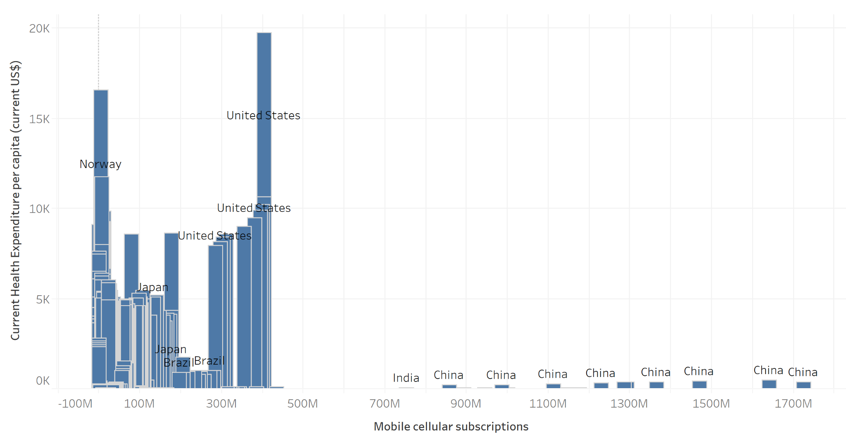
Figure 1: Bar Chart of the number of Mobile cellular subscriptions and the Current health expenditures per capita
Figure 1: Bar Chart of the number of Mobile cellular subscriptions and the Current health expenditures per capita
Figure 1 displays a bar chart where the x-axis represents the number of mobile cellular subscriptions and the y-axis represents the current health expenditures per capita.
The chart does not indicate a clear association between the two variables. For example, United States and China’s mobile cellular subscriptions increased when their current health expenditures increased. But Brazil and Japan’s mobile cellular subscriptions increased when their current health expenditures decreased.
The findings suggest that World Leaders should not only focus on the growth of internet technologies, but could invest their resources more in health care area.

Slide 6
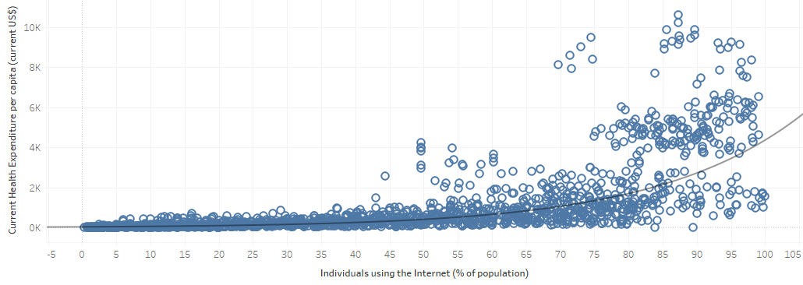
Figure 2: Scatter Plot of percentage of individuals using the Internet and Current health expenditure
Figure 2: Scatter Plot of percentage of individuals using the Internet and Current health expenditure per capita
Figure 2 displays a Scatter Plot chart where the x-axis shows the percentage of individuals using the Internet in population, and the y-axis shows the current health expenditure per capita.
The chart shows a positive relationship between the variables, with the increased percentage of individuals using the internet, the current health expenditure increases as well.
It also has a exponential relationship between the two variables, the r-squared is 0.75, the P value is less than 0.0001.
This chart indicates that if the government spends more money on health expenditure for their citizens, the percentage of individuals using the Internet is high as well.

Slide 7
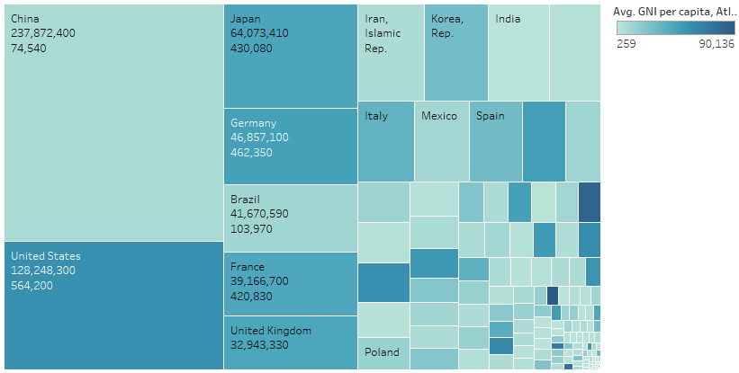
Figure 3: Tree Map of Fixed telephone subscriptions vs GNI per capita
Figure 3 Tree Map of Fixed telephone subscriptions vs GNI per capita
Figure 3 displays a Tree Map where the Size of the block represents Fixed telephone subscriptions and Color represents GNI per capita. Each block represents the average Fixed Telephone Subscription and average GNI per capita for each country over the ten years of the dataset.
The chart shows some positive correlation between the two variables, but this is disrupted by some major instances where the correlation is not so strong. Therefore, there may be a strong link between the two variables, but GNI per capita explanatory forces can vary so wildly that the link may not hold true in most cases.
The mixed nature of the results means governments should focus on the link between internet access and GDP for economics rather than GNI. They should seek other factors that more directly associate with GNI for affecting GNI.

Slide 8
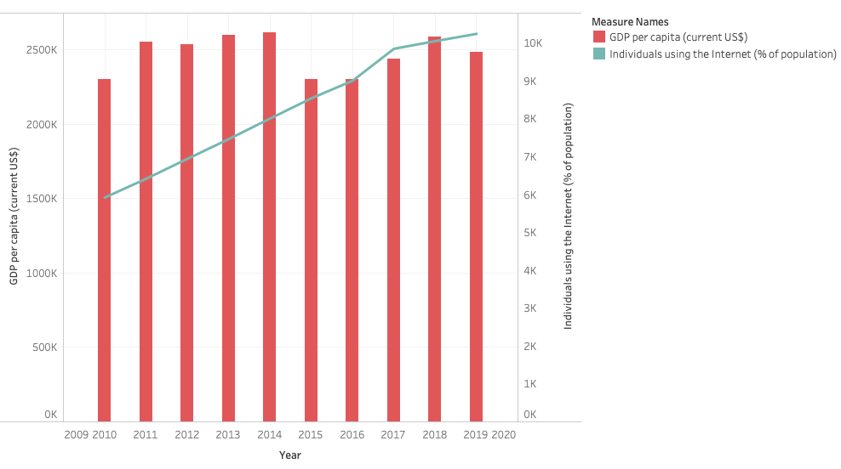
Figure 4: Dual Combination of Individual using the internet and GDP per capita
Figure 4: Dual Combination of individual using Internet and GDP per capita
Figure 4 displays a dual combination chart showing the relationship between individual using Internet and GDP per capita by year, where x-axis represents year and y-axis represents values.
The chart shows that there is a positive relationship between individual using Internet and GDP per capita, as percentage of individual using Internet increase, GDP per capita increases as correspondingly.
The findings suggest that there is a strong correlation between percentage of individual using Internet and GDP per capita, so if a country wants to increase GDP per capita, they could encourage people using Internet more actively.

Slide 9
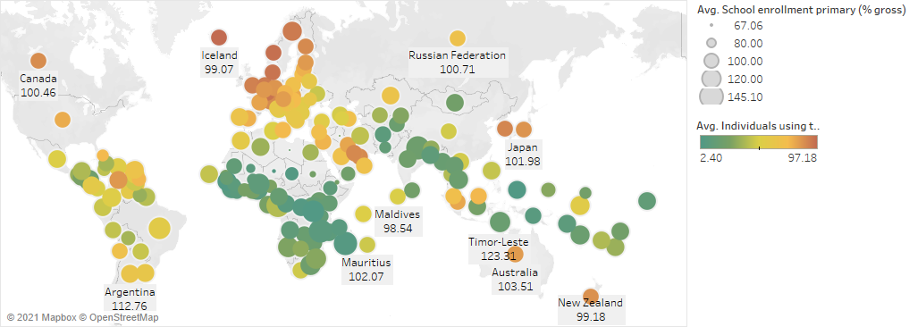
Figure 5: Symbol map of average percentage of individuals using the Internet and average percentage of school enrollment
Figure 5: Symbol map of average percentage of individuals using the Internet and average percentage of school enrollment
Figure 5 displays a Symbol Map chart where it shows each country’s real longitude and latitude in the map: the size of each circle represents average school enrollment, the color represents average individuals using the Internet.
The chart on average, it shows a positive correlation between the average individuals using the Internet and percentage of school enrollment. In other words, as average individuals using the Internet increases, the school enrollment increases.
It indicates that education is strongly linked to technology development. The government should focus on both education and technology development in order to achieve both improvement.

Slide 10
Conclusions
In reference to Hypothesis 1: Internet access is positively correlated with Healthcare expenditure
There was no clear association between Mobile Cellular Subscriptions and Current Health Expenditures, but there was a positive association between the Individuals using the Internet and Current Health Expenditure.
In reference to Hypothesis 2: Internet access is positively correlated with Macroeconomic indicators
Internet access has some positive association with GNI per capita in some countries but the association is not prevalent in all. However there is a positive relationship between Individual using Internet and GDP per capita.
In reference to Hypothesis 3: Internet access is positively correlated with education level
Individuals using the Internet is positively associated with School Enrollment.

Slide 11
Scope & Limitations
Data quality:
Secondary source data - have some missing values
This study only uses a subset of variables from the World Bank website
This study is limited to examining association and correlations and does not investigate causality
Could have more control variables

Slide 12
Implications & Recommendations
Promoting the expansion of Internet access likely will correlate with a conducive environment for the betterment of Healthcare, Productivity and School Enrollment.
Outside of Internet Access, we found many countries could invest more in healthcare.
Governments should focus on Education, Technology and Communications development as in order to achieve strong improvement.

